Slide 1
EXCEL ENGINEERING COLLEGE(AUTONOMOUS)
DEPARTMENT OF COMPUTER SCIENCE & ENGINEERING
IMAGE CAPTION GENERATOR USING DEEP LEARNING
Project Guide:
Mrs. N.NANDA KUMAR M.E.,
Team members : Praveen A (20CS086) Rampradeep J (20CS093)
Thamarai selvan G (20CS116) Suriya Prakash P (20CS114)

Slide 2
Introduction:
Every day, we are bombarded with photos in our surroundings, on social media ,and in the news .Only humans are capable of recognizing photos. We humans can recognize photographs without their assigned captions ,but machines require images to be taught first.
Image Caption Generator models uses input vectors to generate valid and acceptable captions.
Image captioning is used in a variety of sectors, including biology, business, the internet, and in applications such as self-driving cars wherein it could describe the scene around the car, and CCTV cameras where the alarms could be raised if any malicious activity is observed.

Slide 3
Literature Survey:
Caption generation is a challenging artificial intelligence problem where a textual description must be generated for a given photograph.
It requires both methods from computer vision to understand the content of the image and a language model from the field of natural language processing to turn the understanding of the image into words in the right order.
CNN is utilized as an encoder in the derived application to extract features from the snapshot or image, and LSTM is used as a decoder to organize the words and generate captions.

Slide 4
Existing System:
These methods involve manual engineering of visual features language conventions that may not capture the complex and diverse patterns present in images and their corresponding captions.
Proposed System :
The suggested system uses deep learning methods to provide an
improved picture caption generator, especially CNNs and LSTMs.
capture the essence of photos and transmit meaningful descriptions in
order to provide captions that are more interesting, contextually relevant, and linguistically coherent.
5
accurate,

Slide 5
Objective:
The project aims to work on one of the ways to context a photograph in simple English sentences using Deep Learning (DL).
The need to use CNN and LSTM instead of working with RNN.
6

Slide 6
SOFTWARE / HARDWARE
SOFTWARE :
Front End : Python
Back End : My Sql
Tool : Python 3.7
IDE : Pycharm 2019.3
OS : 64bit Windows 10/11
HARDWARE :
CPU TYPE : Intel / Amd *64bit With 2 Core
CLOCK SPEED : 2 GHZ & Above
RAM : 8 / 16 GB
DISK SPACE : 20 GB /Above

Slide 7
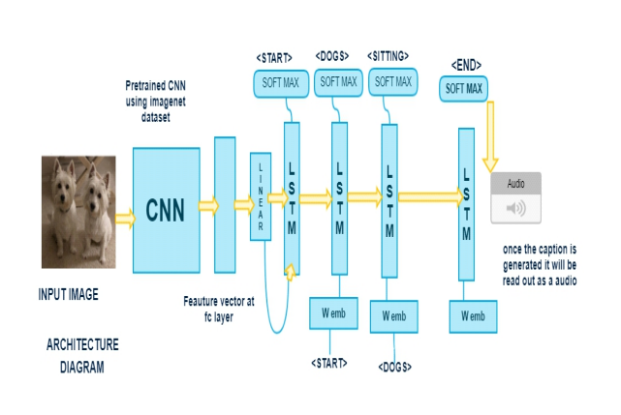
BLOCK DIAGRAM

Slide 8
Algorithm:
Convolutional Neural Network
Long Short-Term Memory
Libraries:
keras
NumPy
TensorFlow

Slide 9
TENSORFLOW:
Tensor flow is an open source library for numerical computation and large-scale machine learning.
It bundles together a slew of machine learning and deep learning models and algorithms makes them useful by way of a common metaphor.
It can be used across a range of tasks but has a particular focus on training and interference of deep neural networks.
Tensor flow is a symbolic math library based on data flow and differentiable programming

Slide 10
KERAS:
Keras is a powerful and easy to use free open source python library for developing and evaluating deep learning models.
It wraps the efficient numerical computation libraries Theano and Tensor flow and allows you to define and train neural network models in just a few lines of code.

Slide 11
IMPLEMENTATION:
• Data Collection and Data Cleaning.
• Extracting Feature Vector .
• Loading Dataset for Training
• Creation of Data Generator.
• Defining Model.
• Training The Model.
• Testing

Slide 12
MODEL :1

Slide 13
MODEL:2

Slide 14
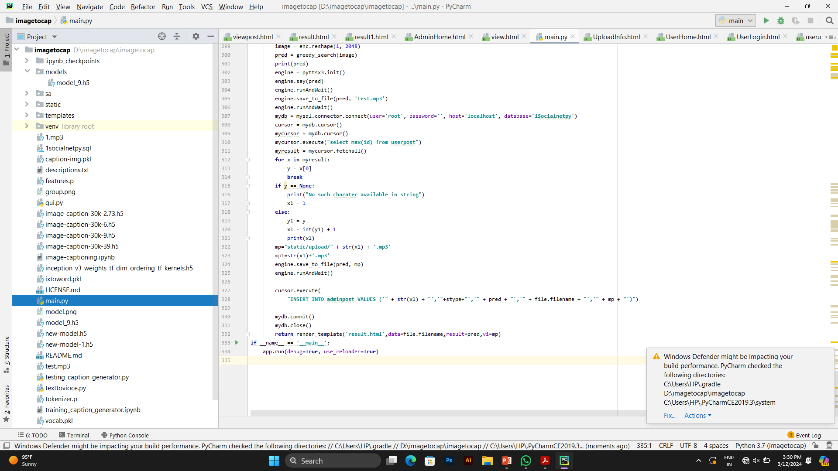
MODEL:3

Slide 15
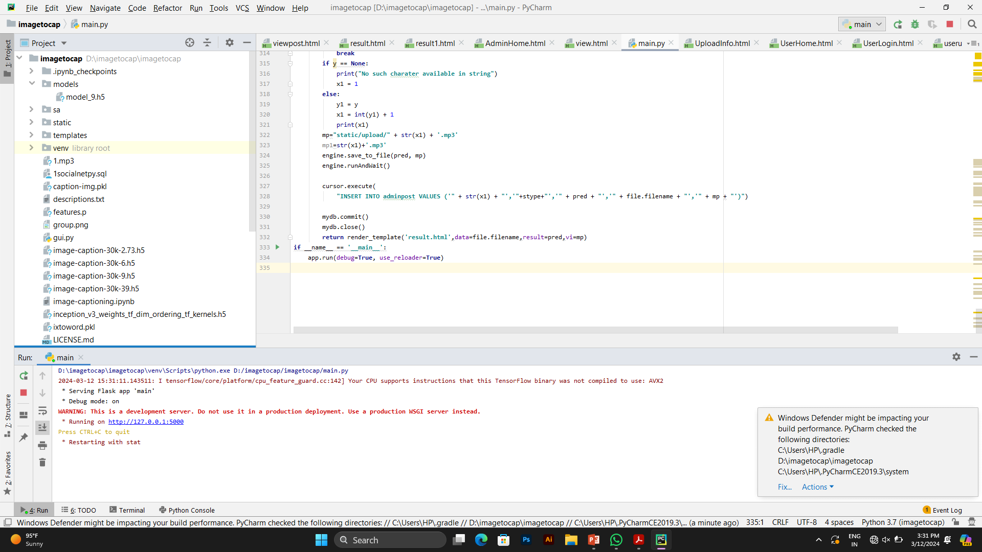
MODEL:4

Slide 16
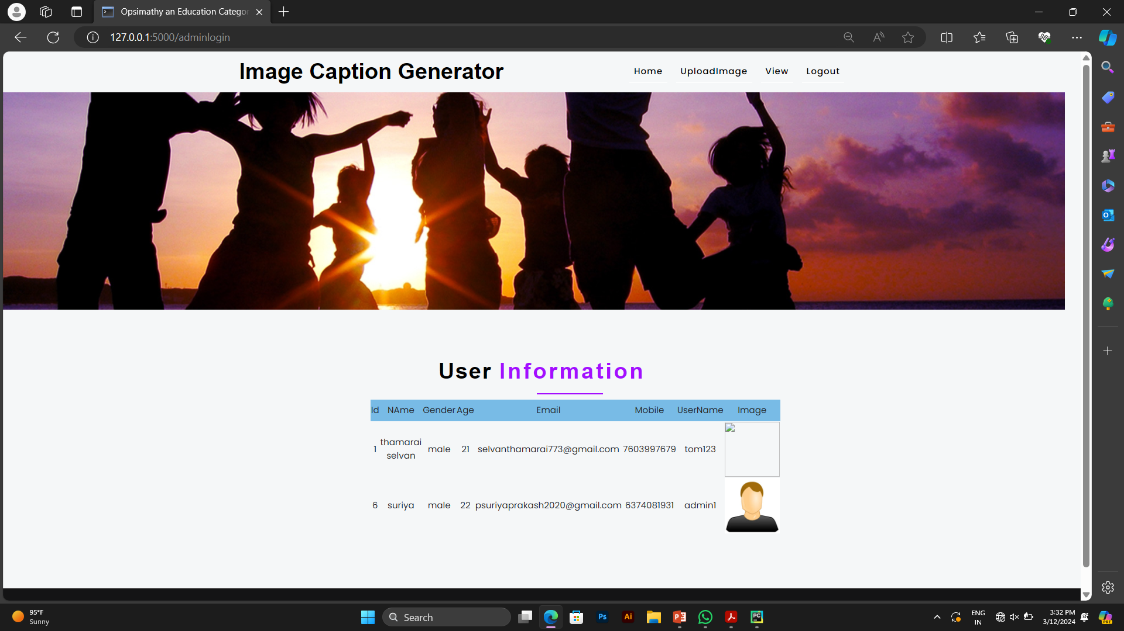
MODEL:5

Slide 17
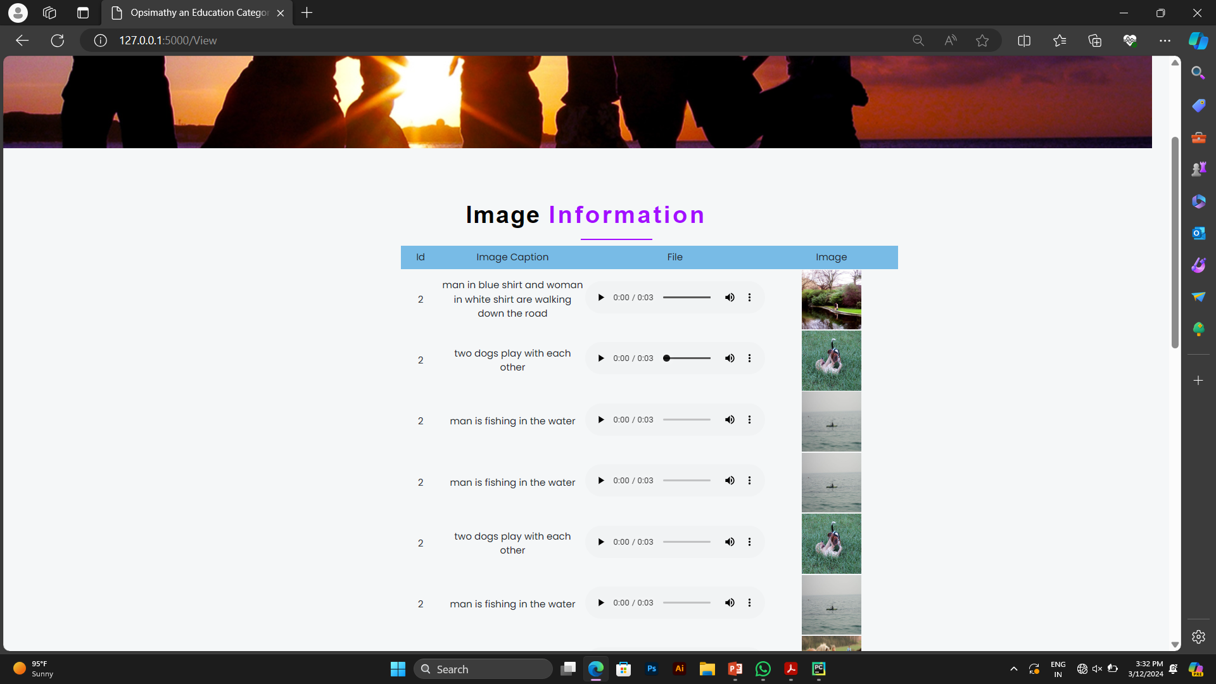
MODEL:6

Slide 18
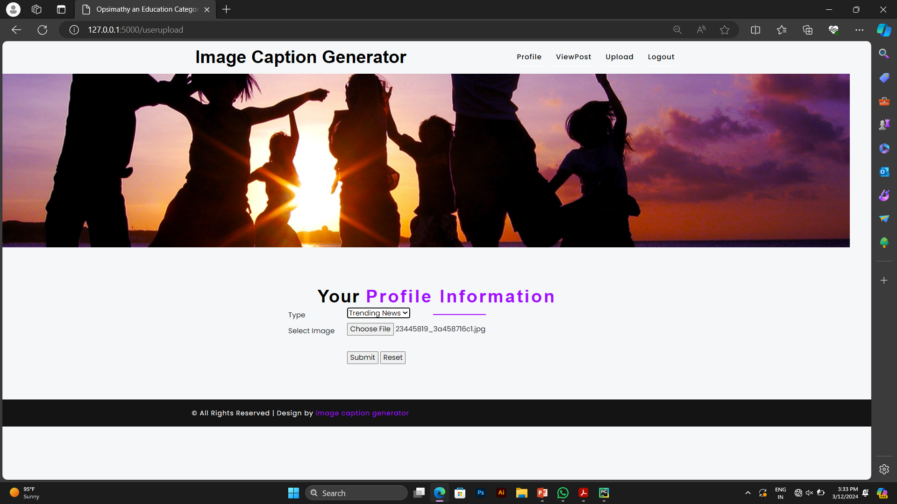
MODEL:7

Slide 19
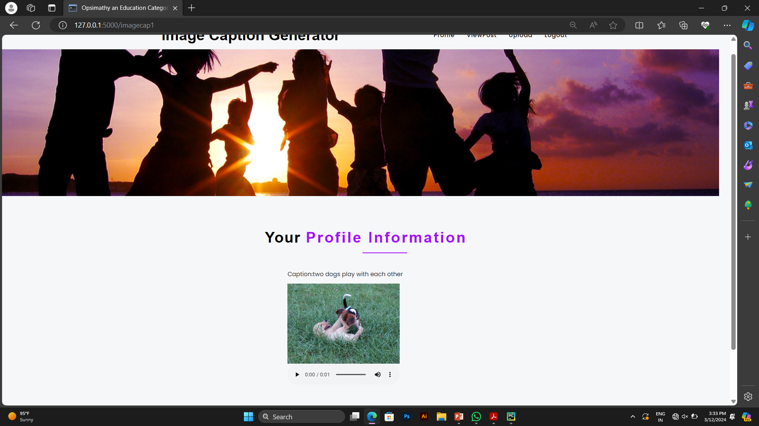
OUTPUT:

Slide 20
Scope:
The application of image captioning in deep learning and securing to become
common computing power is one of the main factors that led to techniques for analysis of new and diverse digital data spreading information and response toward users for quick understanding of information with just an image.

